Slide 1


Slide 2
Learn Creating a GitHub Repository, Building a Website, & Hosting it on GitHub to Showcase your Resume.
HOST : Rishabh Singh
(Alpha Microsoft Learn Student Ambassador)
CO-HOST : Aditya Kumar
(Gold Microsoft Learn Student Ambassador)

Slide 3





Flow of this Session
1. Session on:
Introduction to GitHub & VS Code
3. Session on:
Introduction to CSS 3
5. Quiz Time & Queries:
Building your own Resume
2. Session on:
Introduction to HTML 5
4. Hands On Session:
Building your own Resume

Slide 4
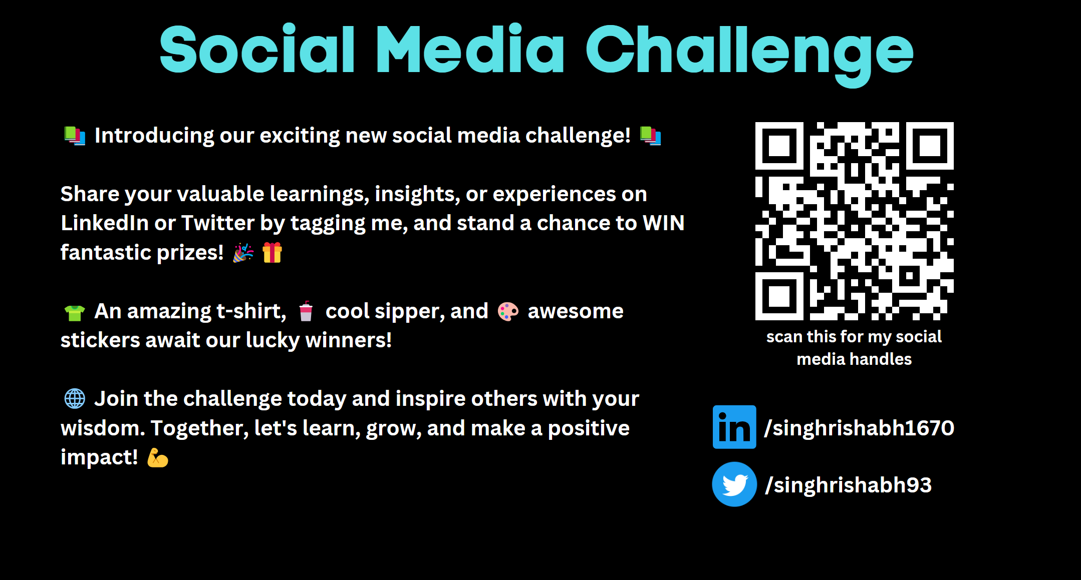

Slide 5

Welcome!
Today, you will learn:
• Set up your coding environment in GitHub
• Learn basic HTML to outline your resume
• Fill in your resume content
• Style your resume with CSS
• Deploying and Hosting your resume using GitHub pages

Slide 6
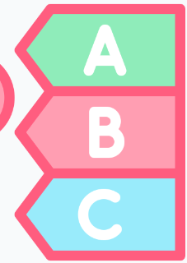
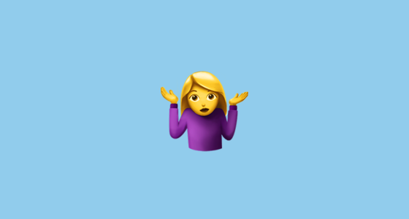
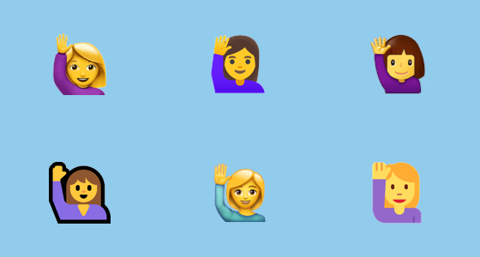

Before we get started:
Do you have knowledge or experience in creating websites?
I’ve never heard about it
I’ve heard of it, and know a thing or two about it
I’ve some knowledge or have studied about it

Slide 7

Prerequisite A GitHub Account A Browser

Slide 8
Let’s Start!

Slide 9
When is the right time to make a website for your resume?
You can use a resume website to update and share your qualifications with ease when you are:
In the process of finding a new job in your field
Changing careers
Looking for freelance opportunities

Slide 10

Getting started with GitHub

Slide 11


Slide 12


Digital Library is used to
Store Books
Share Books

Slide 13
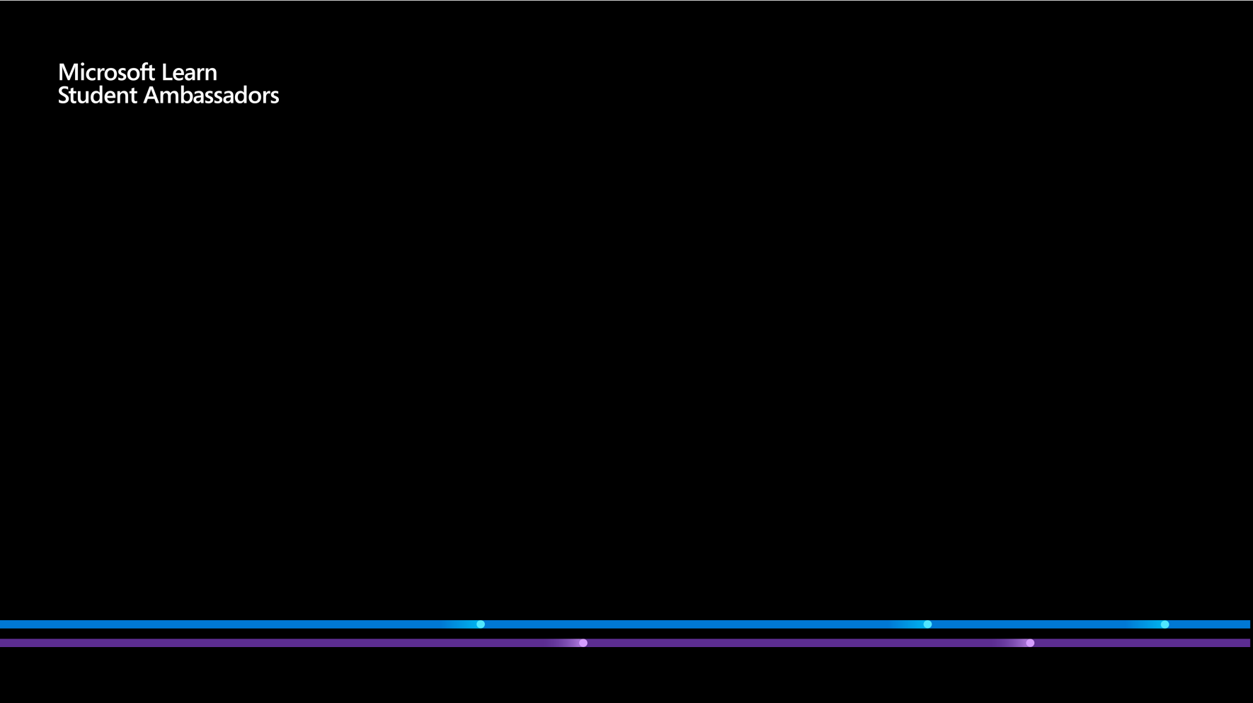



Store and Share their Computer Code or Projects
Developers
GitHub

Slide 14
What is GitHub?
GitHub is an online platform that enables version control and collaboration in software development.
It provides repositories for storing and managing code, allowing public access and editing by others.
GitHub supports popular programming languages like HTML, CSS, and JavaScript used in web page development.

Slide 15
To use GitHub Pages, you need to create a repository with a specific name format: best-resume-ever
You can create a resume website by creating an HTML and CSS file and pushing them to your GitHub repository.
GitHub Pages will automatically generate a website from the files in your repository, which can be accessed at <your-username>.github.io. https://singhrishabh93.github.io/best-resume-ever/

Slide 16

Microsoft Visual Studio is a comprehensive software development environment provided by Microsoft.
It utilizes Microsoft platforms like Windows API, Windows Forms, Windows Presentation Foundation, Windows Store, and Microsoft Silverlight.
It facilitates the creation of both console and graphical user interface applications.
Visual Studio supports multiple programming languages and can accommodate nearly any programming language in its code editor and debugger.
The source code of Visual Studio consists of an extensive 50 million lines of code.

Slide 17

HTML
HTML stands for HyperText Markup Language
It is the standard language used for creating web pages.
HTML is a markup language that uses tags to indicate the structure of a document.
HTML documents can also include lists, tables, forms, and other types of elements to organize and display content.
HTML5 is the latest version of HTML and includes new features such as video and audio elements, semantic tags, and form input types.

Slide 18
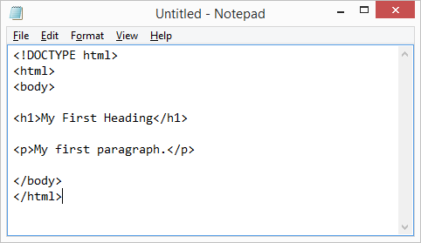
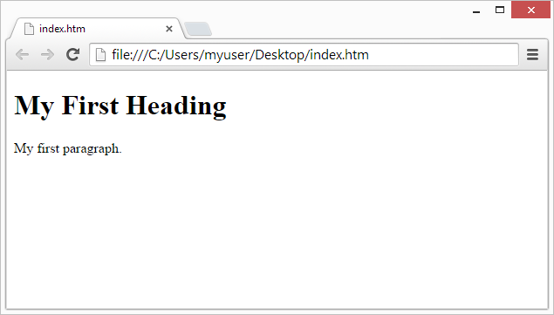
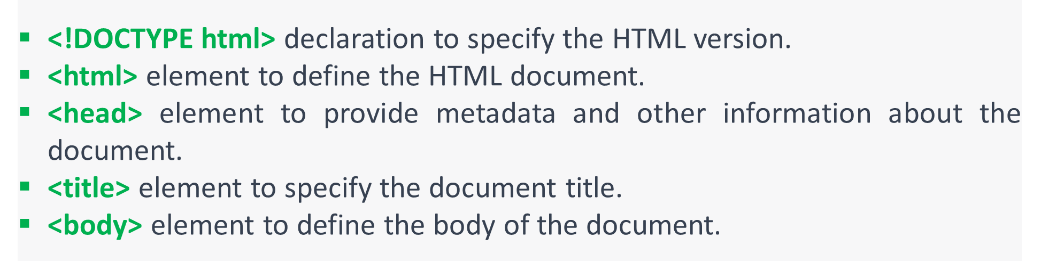
HTML Code
Output

Slide 19
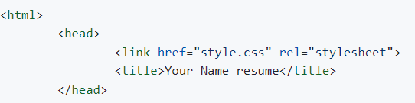
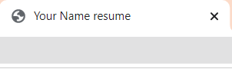
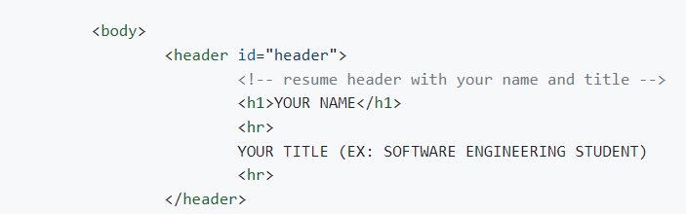
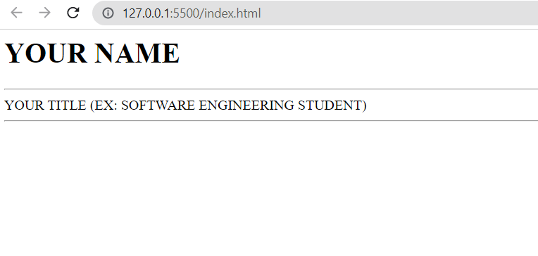

Slide 20
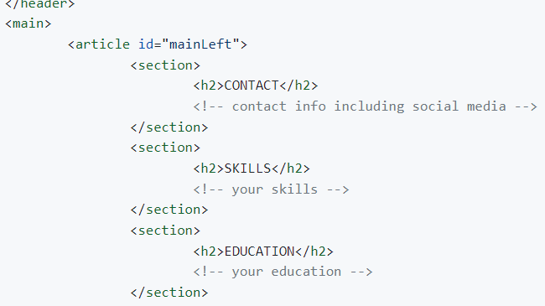
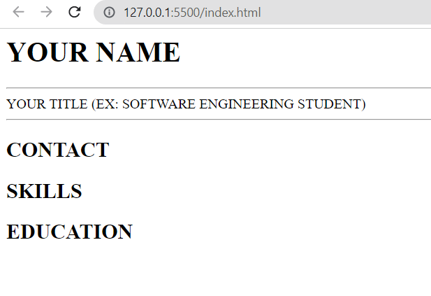
<main> and </main>: This is the opening and closing tag of the main section of the HTML document. The main section typically contains the main content of the webpage.
<article id="mainLeft"> and </article>: This is the opening and closing tag of an article element with an id attribute of "mainLeft". The article element represents a self-contained piece of content within a document, such as a blog post, a news article, or a user comment.
<section> and </section>: These are the opening and closing tags of a section element, which groups together related content on a webpage.

Slide 21
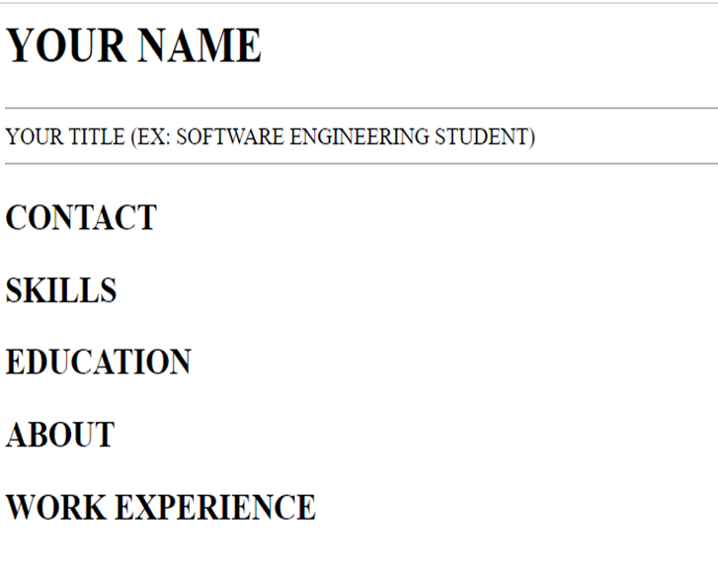
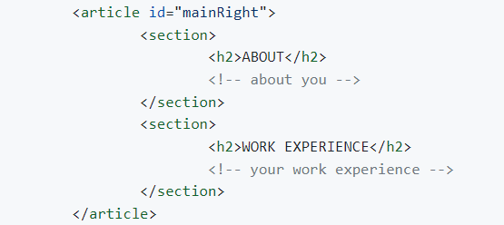
<article id="mainRight"> and </article>: This is another article element with an id attribute of "mainRight". It contains two section elements i.e About and Work Experience.

Slide 22
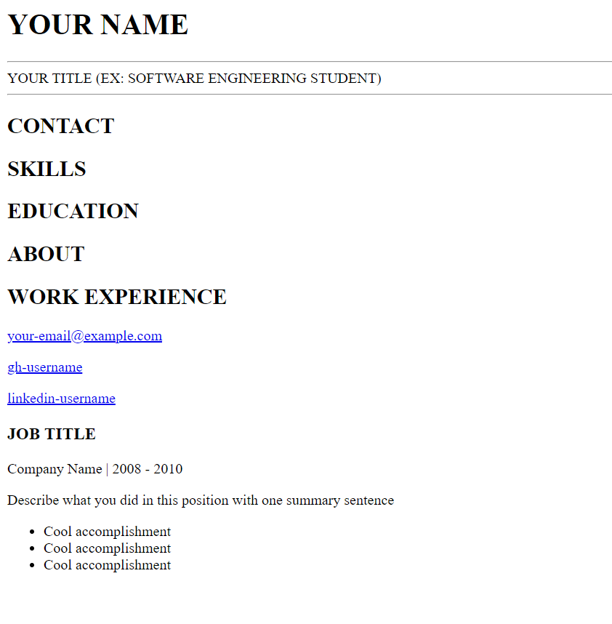
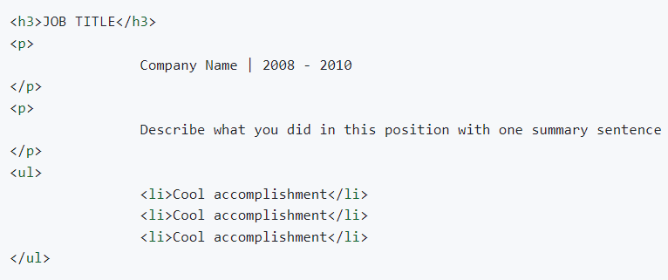

Lists come in two varieties in HTML:
Ordered (with numbers or letters)
Unordered (bullet points
“li” indicates each "list item" in a list.
Let's use an unordered list to create a list of our work experience.

Slide 23
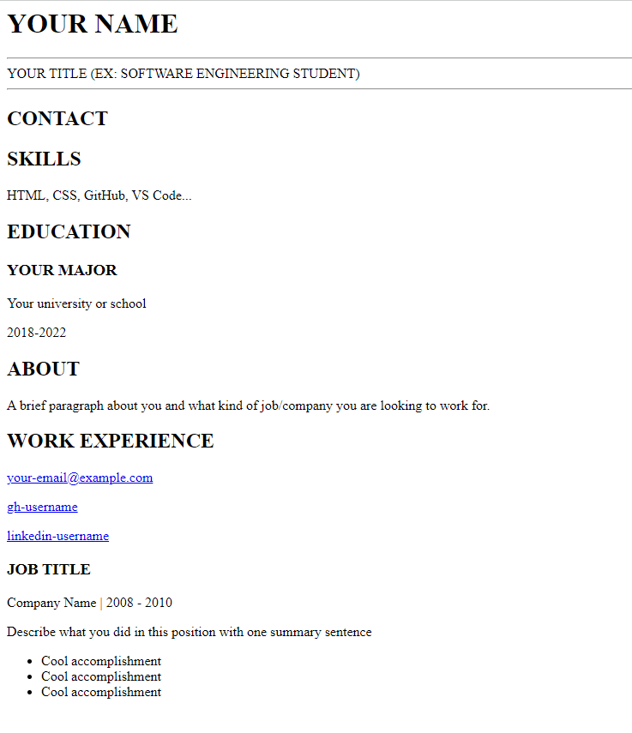
Let’s transform this!

Slide 24
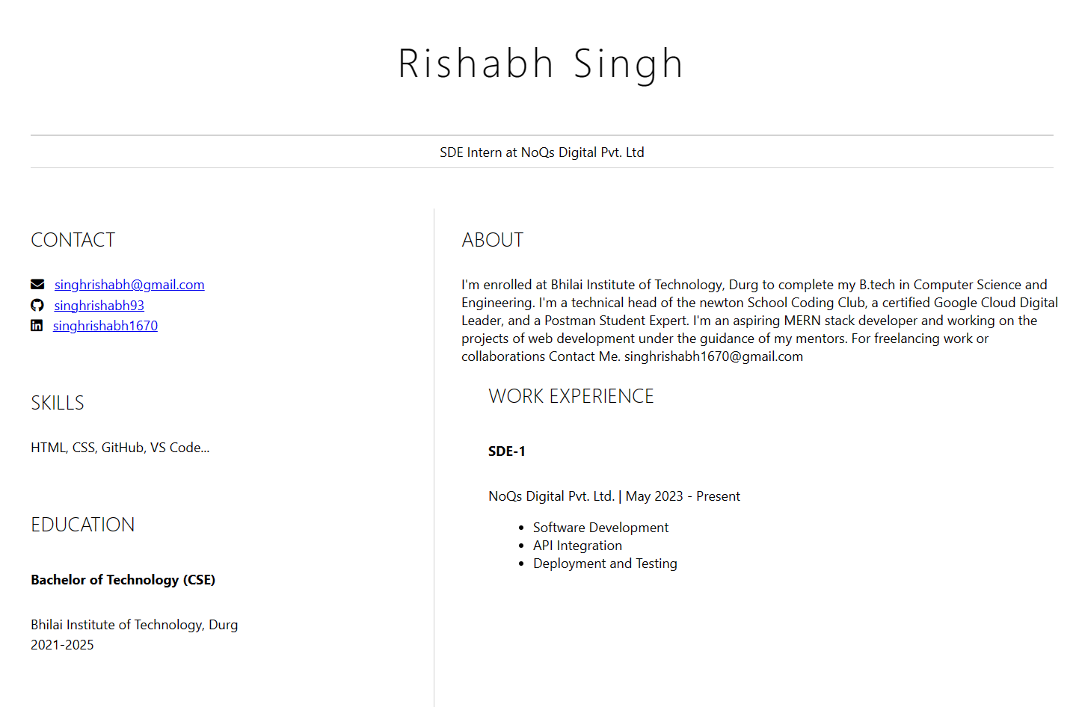

Slide 25
What is the secret behind this remarkable change?

Slide 26
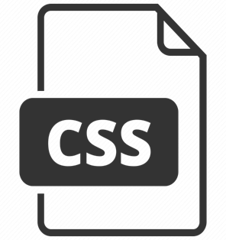
What is CSS?
Cascading Style Sheets, fondly referred to as CSS, is a simple design language intended to simplify the process of making web pages presentable.

Slide 27
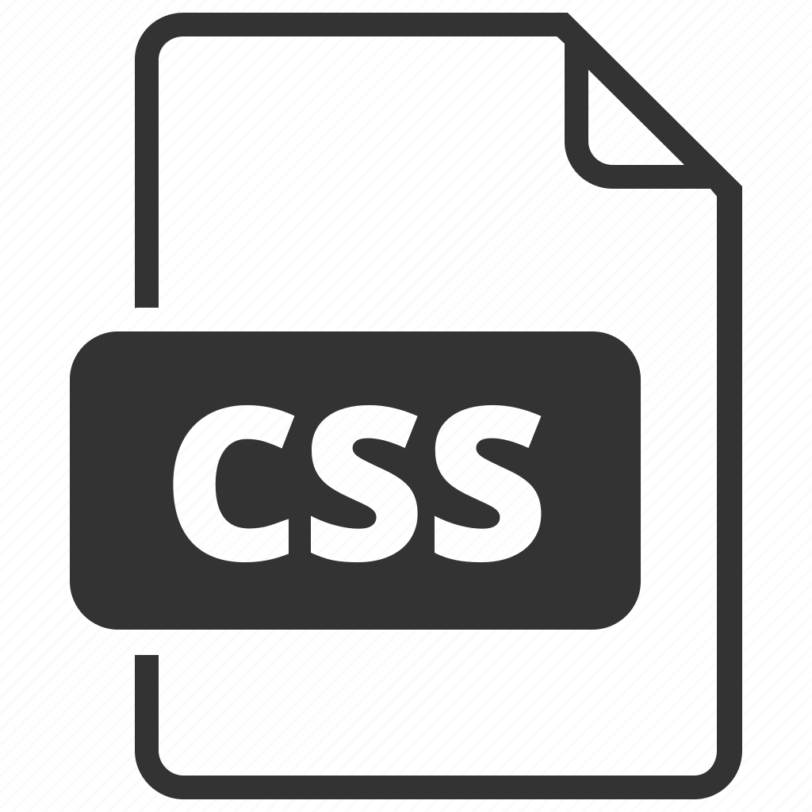
CSS
CSS stands for Cascading Style Sheets, which is a language used to style and format HTML documents.
It allows you to separate the content of a document from its presentation, making it easier to maintain and update.
It uses selectors to target specific elements on a page, such as headings, paragraphs, or images.
CSS properties are used to style elements, such as changing the font, color, or background.
It can also be used to add interactivity to a web page, such as hover effects or animations.

Slide 28


Slide 29
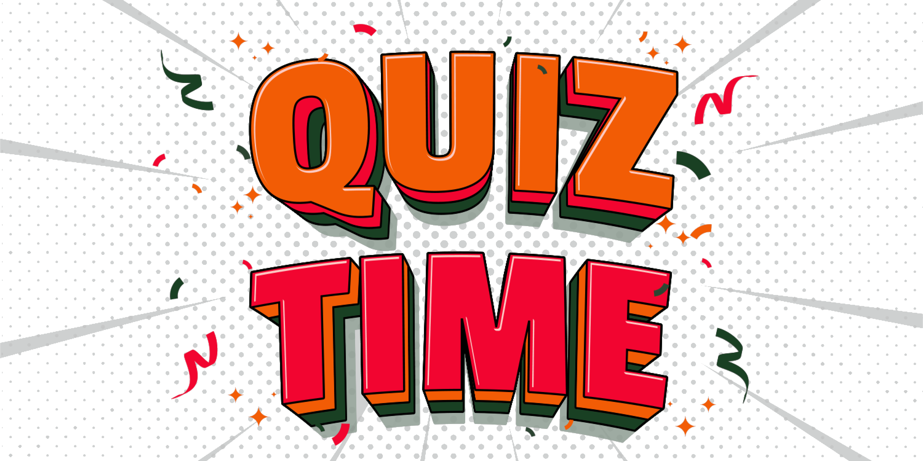

Slide 30

Before we conclude this session, Could you kindly indicate which of the following options best reflects your experience:
I have gained some new knowledge & I now have a better understanding of it.
I am still facing challenges with learning.
Boom! I will be able to create a website

Slide 31

It’s time to capture a photo

Slide 32



Thank You!
Don't hesitate to get in touch with me through my social media channels!
https://www.linkedin.com/in/singhrishabh1670/
rishabh.singh1@studentambassadors.com
https://github.com/singhrishabh93
https://www.twitter.com/singhrishabh93

